Slide 1

Green Pace
Security Policy Presentation
Developer: Dylan Ngu

Slide 2

OVERVIEW: DEFENSE IN DEPTH
This security policy is a standardized version of the implicit best practices of developers at Green Pace.
Its purpose is to establish a set of rules and guidelines to ensure all applications are developed using a consistent implementation of secure principles.

Slide 3
THREATS MATRIX
Severity of Vulnerability
Low Priority: Unlikely to happen and low severity
Likely: Likely to happen and low severity
Unlikely: Unlikely to happen and high severity
Priority: Likely to happen and high severity
Likely STD-001-CPP | Priority STD-003-CPP STD-004-CPP STD-005-CPP STD-009-CPP
Low priority STD-006-CPP STD-007-CPP | Unlikely STD-002-CPP STD-008-CPP STD-010-CPP
Likelihood of Vulnerability

Slide 4
10 PRINCIPLES
Principle |  | Coding Standards
1 | Validate Input Data | STD-001-CPP, STD-002-CPP, STD-003-CPP, STD-004-CPP, STD-008-CPP, STD-010-CPP
2 | Heed Compiler Warnings | STD-005-CPP, STD-007-CPP
3 | Architect and Design for Security Policies | STD-003-CPP, STD-004-CPP, STD-006-CPP, STD-007-CPP, STD-010-CPP
4 | Keep it Simple | STD-002-CPP, STD-003-CPP, STD-008-CPP
5 | Default Deny | STD-004-CPP, STD-009-CPP
6 | Adhere to the Principle of Least Privilege | STD-004-CPP
7 | Sanitize Data Sent to Other Systems | STD-004-CPP
8 | Practice Defense in Depth | STD-004-CPP
9 | Use Effective Quality Assurance | STD-005-CPP, STD-007-CPP, STD-009-CPP
10 | Adopt a Secure Coding Standard | STD-001-CPP…STD-010-CPP (ALL)

Slide 5
CODING STANDARDS
Code | Coding Standard | Severity | Likelihood
STD-004-CPP | Exclude user input from format strings or functions | High | Likely
STD-009-CPP | Do not attempt to create a std::string from a null pointer | High | Likely
STD-005-CPP | Detect and handle all memory allocation errors | High | Likely
STD-003-CPP | Guarantee that storage for strings has sufficient space for character data and the null terminator. | High | Likely
STD-002-CPP | Guarantee that container indices and iterators are within the valid range | High | Likely
STD-008-CPP | Use valid iterator ranges | High | Probable
STD-010-CPP | Allocate sufficient memory for an object | High | Probable
STD-001-CPP | Call functions with the correct number and type of arguments. | Medium | Probable
STD-006-CPP | Do not use assertions for handling runtime errors or input validation | Medium | Unlikely
STD-007-CPP | Handle all exceptions | Low | Probable

Slide 6
ENCRYPTION POLICIES
Encryption Type | Policy
Encryption at Rest | Encryption at rest refers to encrypting stored data in order to protect it from unauthorized access. Our Policy will be to encrypt all sensitive data that is being stored in databases using the AES-256 encryption algorithm.
Encryption in Flight | Our policy of encryption in flight outlines how we will protect data that is being transmitted between different locations. We will use TLS communication protocol and key lengths AES-128 or higher to protect data in transit if it were to be intercepted by unauthorized users.
Encryption in Use | Our encryption in use policy will specify which data requires encryption while it is being actively used. One example is encrypting passwords and performing computations using the encrypted data. When verifying password correctness, we will compare the hash value against the one stored, thus never exposing the password in plaintext.

Slide 7
TRIPLE-A POLICIES
Tripple-A Framework | Policy
Authentication | Authentication is the process identifying a user and confirming the user is whom they claim to be. Our policy to support authentication will be to use multi-factor authentication (MFA) and implement strict identity verification procedures. This policy supports the principle of default deny, meaning access is only granted after security conditions are met.
Authorization | Authorization is the process of determining which privileges and permissions an authenticated user has. Our policy will be to use role-based access control (RBAC) to enforce the principle of least privilege; users can only access the minimal resources needed for completing their task.
Accounting | Accounting is the process of providing records of who did what within the system. To support accounting, our policy will be to utilize logging, real-time monitoring, and network segmentation. This will allow us to monitor our systems in order to detect and contain any possible malicious activity.

Slide 8
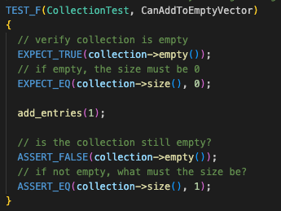
Unit Testing
CanAddToEmptyVector – Positive Test

Slide 9
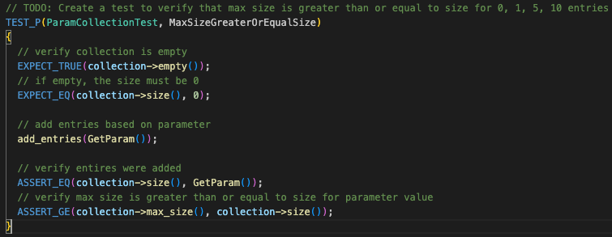
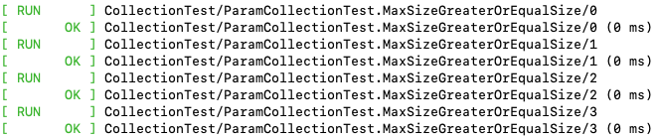
Unit Testing
MaxSizeGreaterOrEqualSize – Positive Parameterized Test

Slide 10
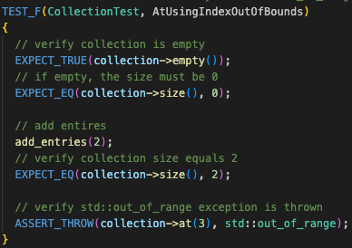
Unit Testing
AtUsingIndexOutOfBounds – Negative Test

Slide 11
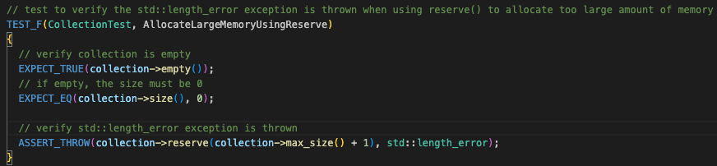
Unit Testing
AtUsingIndexOutOfBounds – Negative Test

Slide 12

AUTOMATION SUMMARY

Slide 13
TOOLS
The DevSecOps pipeline shows how secure practices can be integrated into every phase of the SDLC to automate security checks and testing.
DevSecOps Stage: | Build | Verify and Test | Transition & Health | Monitor & Detect
Security Tools: | Compiler Static Code Analyzer Unit Tests | SAST DAST Integration Test | Penetration Testing | Automated Logging

Slide 14
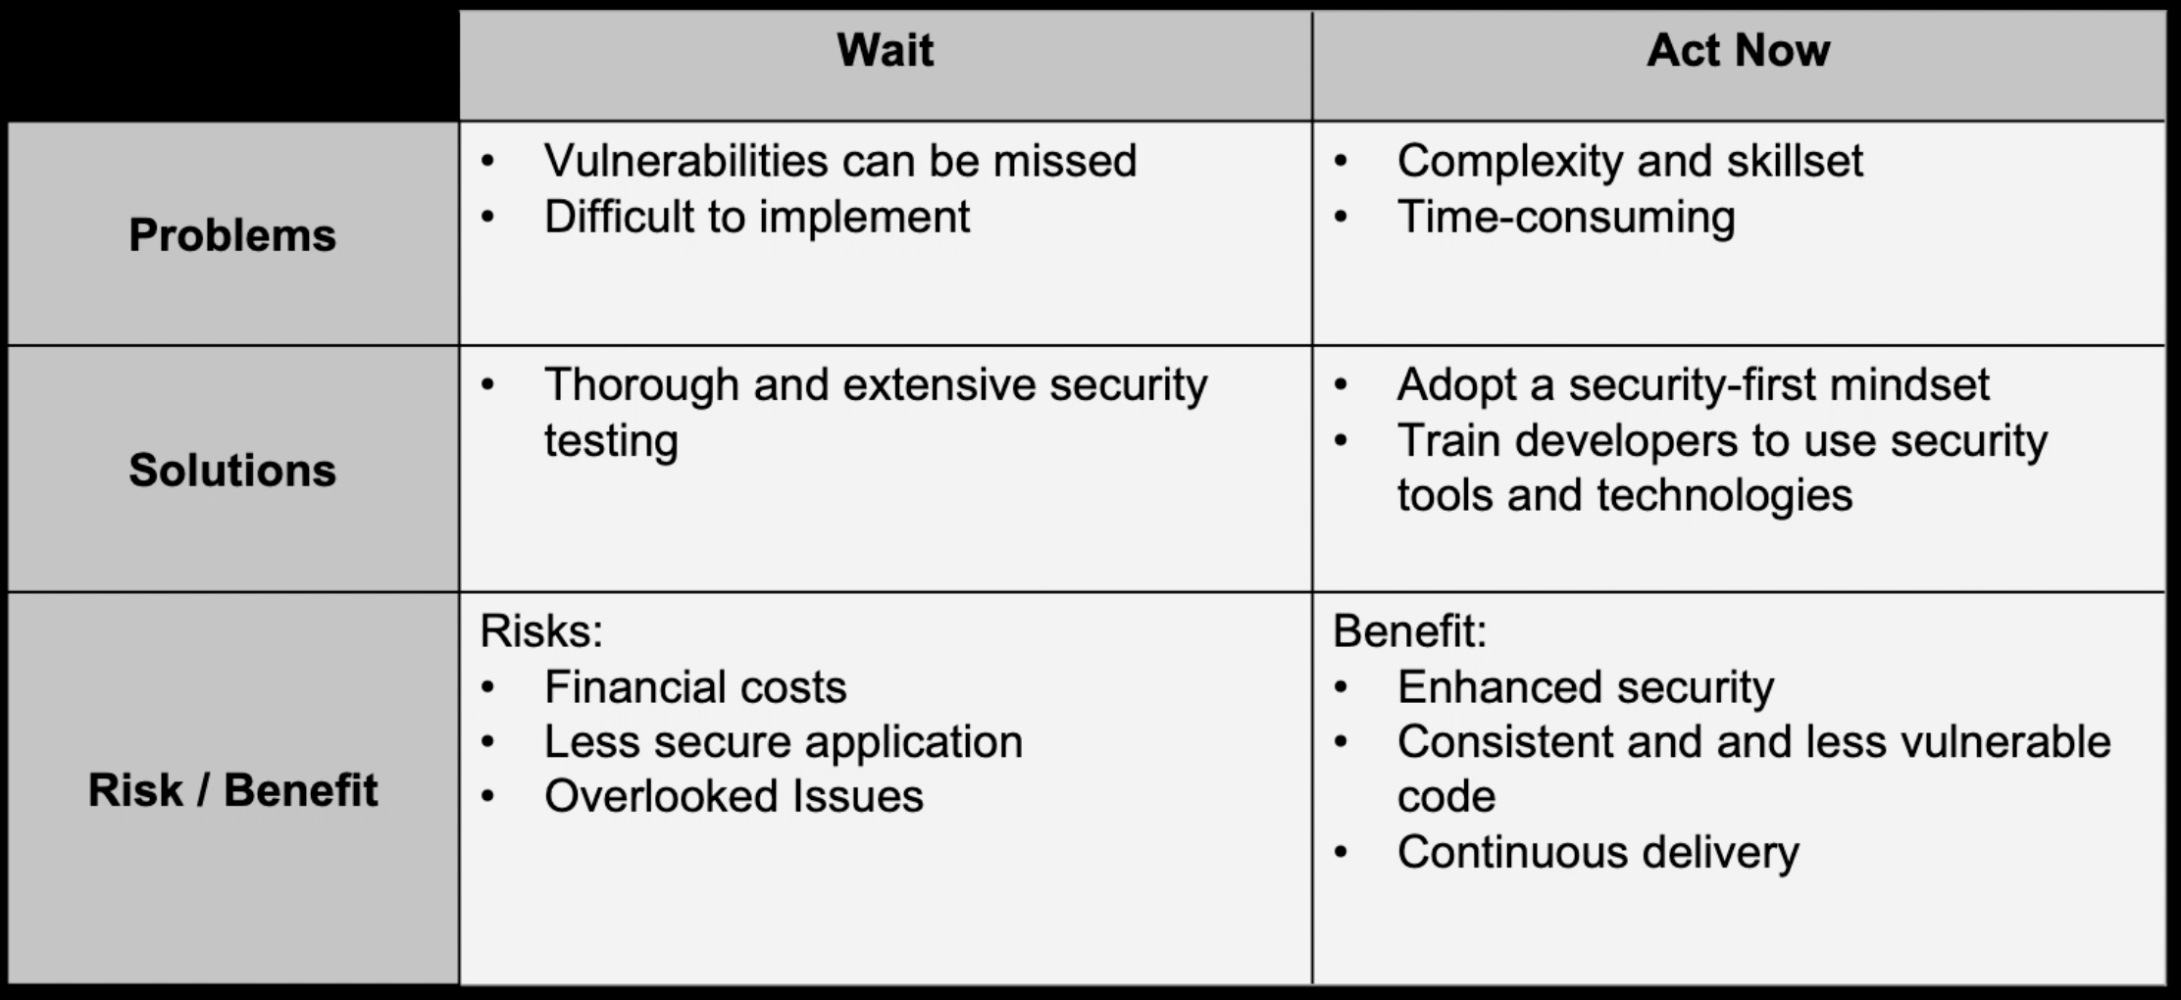
RISKS AND BENEFITS

Slide 15
RECOMMENDATIONS
Potential Gaps in Security Policy
Incident Response Plan
Legal and Regulatory Requirements
Software Patches

Slide 16
Real-World Example
MGM Resorts Cyberattack
Ransomware attack initiated through social Engineering
Gained access to internal systems
$100 million financial loss

Slide 17
CONCLUSIONS
Training and Awareness programs
Conduct regular security audits
Periodic policy review and maintenance
Ensure compliance with security policies

Slide 18
REFERENCES
Cyber Security Risk Assessment Matrix | BitSight. (2025, May 12). Www.bitsight.com. https://www.bitsight.com/glossary/cyber-security-risk-assessment-matrix
How to establish an application security policy. (2023, November 8). Escape - the API Security Blog. https://escape.tech/blog/how-to-establish-an-application-security-policy/
Jones, D. (2023, October 6). MGM Resorts’ Las Vegas area operations to take $100M hit from cyberattack. Cybersecurity Dive. https://www.cybersecuritydive.com/news/mgm-las-vegas-100m-hit-cyberattack/695852/?ref=escape.tech
What is DevSecOps? Benefits, Challenges and Best Practices. (2025, May 20). SentinelOne. https://www.sentinelone.com/cybersecurity-101/cybersecurity/what-is-devsecops/#challenges-of-devsecops

